Slide 1
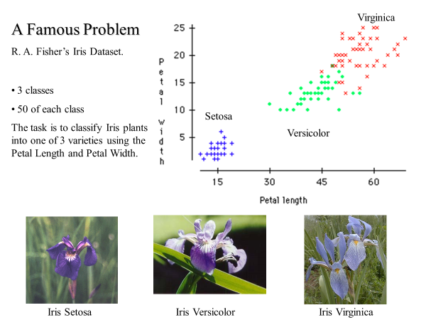
CS 235 Decision Tree Classification
Recall the Iris dataset? This dataset is so famous….
.. it has its own Wikipedia page!
.. It is built into matlab
To load it, type
>> load fisheriris
If I type whos
>> whos
Name Size Bytes Class Attributes
meas 150x4 4800 double
species 150x1 19300 cell
…we can see how it is organized
The variable meas has the features, lets see just the first five items…
>> meas(1:5,:)
ans =
5.1000 3.5000 1.4000 0.2000
4.9000 3.0000 1.4000 0.2000
4.7000 3.2000 1.3000 0.2000
4.6000 3.1000 1.5000 0.2000
5.0000 3.6000 1.4000 0.2000
https://en.wikipedia.org/wiki/Iris_flower_data_set

Slide 2
The variable species has the class label features. Note that they are in the matlab cell data structure
Let us take a look at them…
>> species
species =
'setosa'
'setosa'
(omitted to save space)
'setosa'
'setosa'
'versicolor'
'versicolor‘
(omitted to save space)
'versicolor'
'versicolor'
'virginica'
'virginica'
(omitted to save space)
'virginica'
'virginica'
For some tasks it might be better if the labels where integers instead of strings, this code converts them..
labels_as_ints =[];
for i=1:150
if strcmp(species{i},'virginica')
labels_as_ints(i) = 1;
elseif strcmp(species{i},'versicolor')
labels_as_ints(i) = 2;
elseif strcmp(species{i},'setosa')
labels_as_ints(i) = 3;
else
disp('error')
end
end
labels_as_ints = labels_as_ints'

Slide 3
Let us build a Decision Tree for Iris.
We are allowed to name the features (or predicators), let us do so.
>> load fisheriris;
>> t = fitctree(meas(idxTrn,:),species(idxTrn),'PredictorNames',{'SepalLen' ' SepalWidth' 'PetalLen' 'PetalWidth'});
t =
Decision tree for classification
1 if PetalLen<2.45 then node 2 elseif PetalLen>=2.45 then node 3 else setosa
2 class = setosa
3 if PetalWidth<1.75 then node 4 elseif PetalWidth>=1.75 then node 5 else versicolor
4 if PetalLen<4.95 then node 6 elseif PetalLen>=4.95 then node 7 else versicolor
5 class = virginica
6 if PetalWidth<1.65 then node 8 elseif PetalWidth>=1.65 then node 9 else versicolor
7 class = virginica
8 class = versicolor
9 class = virginica
The result is a list of rules, not a tree. But they are equivalent, let us see the tree (next slide)
>> view(t,'Mode','graph')

Slide 4
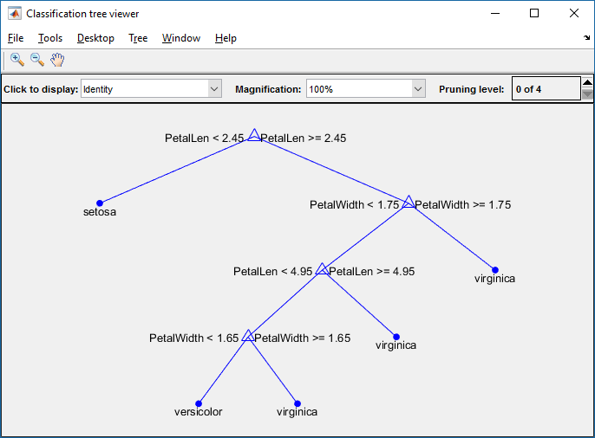
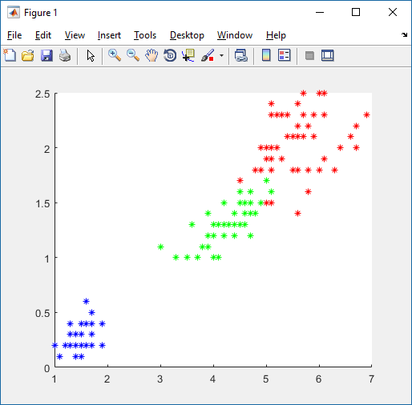
Notice that the tree did not use 'SepalLen‘ or ' SepalWidth‘, Why?
At least two possibilities
Those features are irrelevant
Those features are relevant, but they are redundant with the features that were used
Ungraded Assignment
Draw the tree’s decision boundary on the scatter plot below
PetalWidth
PetalLen
hold on;, scatter(meas(1:50,3), meas(1:50,4),'b*' );, scatter(meas(51:100,3), meas(51:100,4),'g*' )', scatter(meas(101:150,3), meas(101:150,4),'r*' )

Slide 5
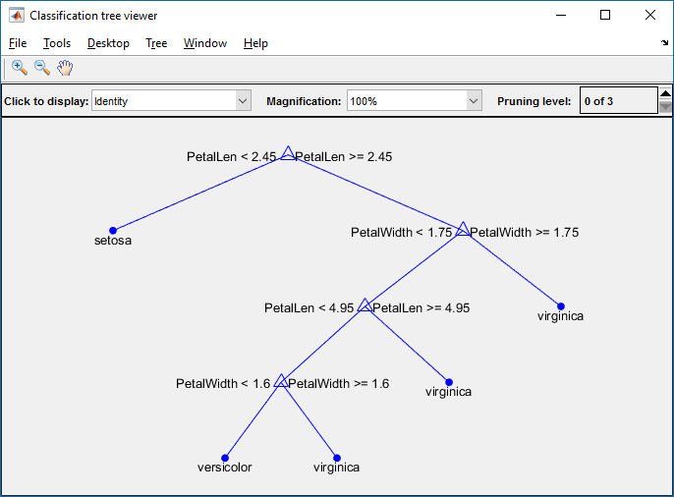
function CS235DT()
load fisheriris % Load the data
n = size(meas,1); % How many instances do we have?
rng(1) % Seed the random number generator for reproducibility
idxTrn = false(n,1); % Initialize a vector of indices to a train subset
idxTrn(randsample(n,round(0.5*n))) = true; % Training set logical indices
idxVal = idxTrn == false; % Validation set logical indices
% Learn a tree ONLY on the idxTrn subset: Call it Md1, as in Model 1
Mdl = fitctree(meas(idxTrn,:),species(idxTrn),'PredictorNames',{'SepalLen' ' SepalWidth' 'PetalLen' 'PetalWidth'});
view(Mdl,'Mode','graph') % Let us see the tree we learned
% Classify ONLY the idxVal subset
label = predict(Mdl,meas(idxVal,:)); % Predict (classify) the test data, on the trained model
[label,species(idxVal)] % Echo the predicted and then true labels side by side
numMisclass = sum(~strcmp(label,species(idxVal))) % How many did we get wrong?
end
Let us learn a tree on half the data, and use it to classify the other half.
Note that you might get a different tree each time, because you are using a random subset. I prevented this by using ‘rng(1)’ in my code. This is just for debugging purposes, you may want to turn it off.
>> CS235DT
ans =
'setosa' 'setosa'
(deleted to save space)
'setosa' 'setosa'
'versicolor' 'versicolor'
'virginica' 'versicolor'
'versicolor' 'versicolor'
'versicolor' 'versicolor'
'versicolor' 'versicolor'
'versicolor' 'versicolor'
'versicolor' 'versicolor'
'versicolor' 'versicolor'
'versicolor' 'versicolor'
'virginica' 'versicolor'
'versicolor' 'versicolor'
'versicolor' 'versicolor'
'versicolor' 'versicolor'
'versicolor' 'versicolor'
'versicolor' 'versicolor'
'versicolor' 'versicolor'
'versicolor' 'versicolor'
'virginica' 'versicolor'
'versicolor' 'versicolor'
(deleted to save space)
'versicolor' 'versicolor'
'(deleted to save space)
'virginica' 'virginica'
'virginica' 'virginica'
numMisclass = 3
Note that all the mistakes here are of the same kind,
We say it is a 'virginica' but is was a 'versicolor‘.
We got three wrong.
Ungraded Assignment
What is the error rate?
Draw the confusion matrix.

Slide 6
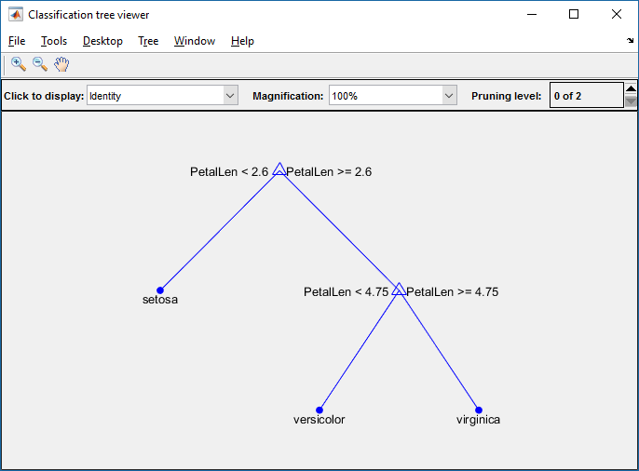
I commented out ‘rng(1)’ and rand the code again.
I got a different tree, and my error rate was 4.
>> CS235DT
ans =
'setosa' 'setosa'
(deleted to save space)
'virginica' 'virginica'
'virginica' 'virginica'
numMisclass = 4
So what is my error-rate? Is it 3/150 or 4/150?
Of course, the best estimate is 3.5/150
We can get an even better estimate by running my code 100 times and averaging (obviously, you should suppress all the plots and text output that I spawn)
MATLAB has cross validation built-in! But we are not going to use it ;-)
function CS235DT()
load fisheriris % Load the data
n = size(meas,1); % How many instances do we have?
% rng(1) % Seed the random number generator for reproducibility
idxTrn = false(n,1); % Initialize a vector of indices to a train subset
idxTrn(randsample(n,round(0.5*n))) = true; % Training set logical indices
idxVal = idxTrn == false; % Validation set logical indices
% Learn a tree ONLY on the idxTrn subset: Call it Md1, as in Model 1
Mdl = fitctree(meas(idxTrn,:),species(idxTrn),'PredictorNames',{'SepalLen' ' SepalWidth' 'PetalLen' 'PetalWidth'});
view(Mdl,'Mode','graph') % Let us see the tree we learned
% Classify ONLY the idxVal subset
label = predict(Mdl,meas(idxVal,:)); % Predict (classify) the test data, on the trained model
[label,species(idxVal)] % Echo the predicted and then true labels side by side
numMisclass = sum(~strcmp(label,species(idxVal))) % How many did we get wrong?
end

Slide 7
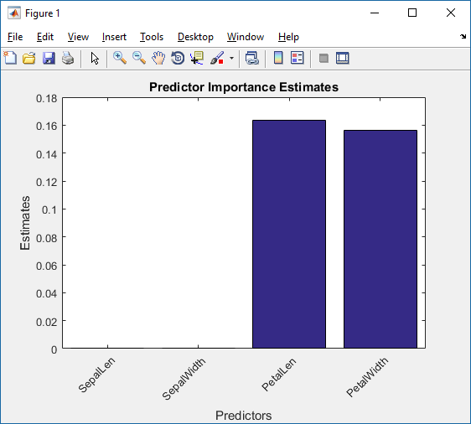
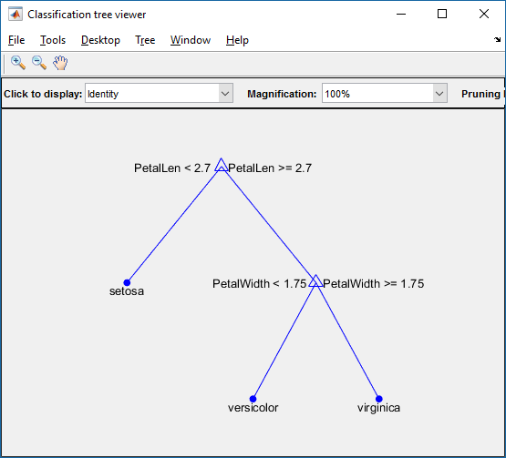
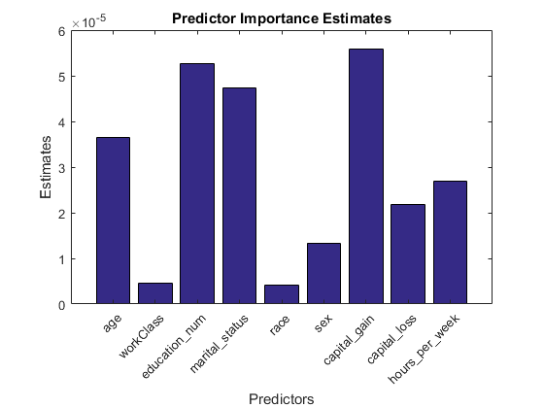
While it is obvious for this small dataset, we can ask matlab what were the most important features it found in this dataset.
(again, this can change for random runs)
% Append this to function CS235DT()
imp = predictorImportance(Mdl);
figure;
bar(imp);
title('Predictor Importance Estimates');
ylabel('Estimates');
xlabel('Predictors');
h = gca;
h.XTickLabel = Mdl.PredictorNames;
h.XTickLabelRotation = 45;
h.TickLabelInterpreter = 'none';
For some datasets, this really can be helpful. Suppose I want to predict a persons salary, given their 'age','workClass','education_num','marital_status','race', 'sex','capital_gain','capital_loss','hours_per_week‘.
What is the most important thing to know? It turns out, their Race is almost irrelevant, but their Capital Gains is very important.

